Slide 1
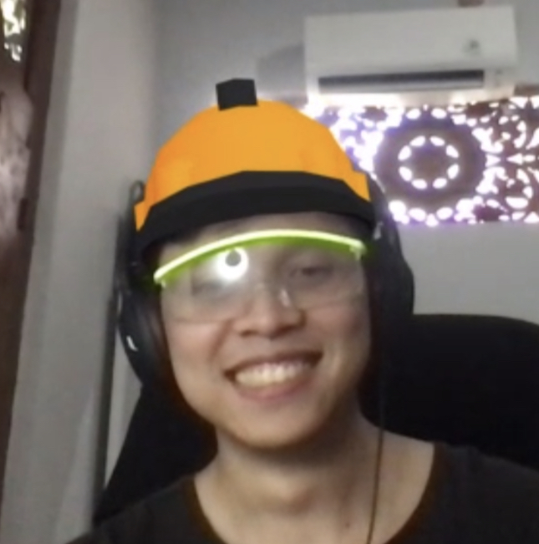
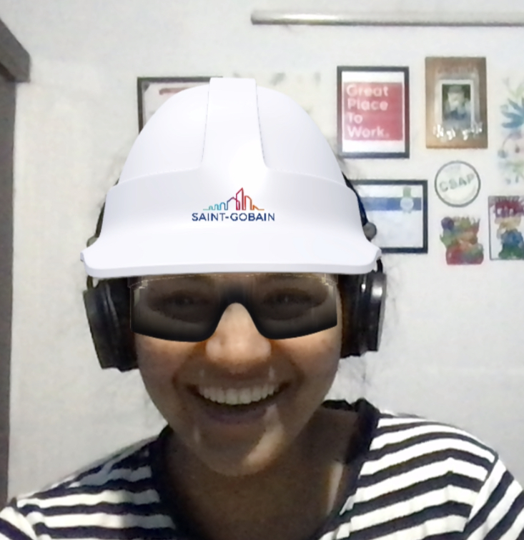
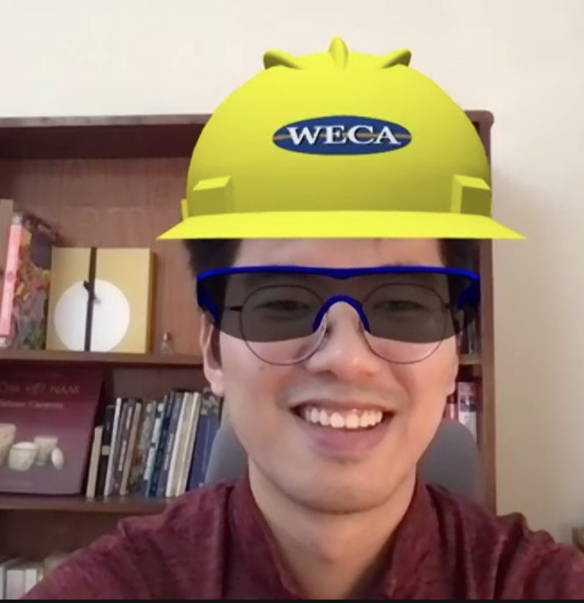
Workplace Safety
Team Alvin: Akbar, Swati, Hung
FY22 ASIC Hackathon
Submission Date: 2022/09/09

Slide 2
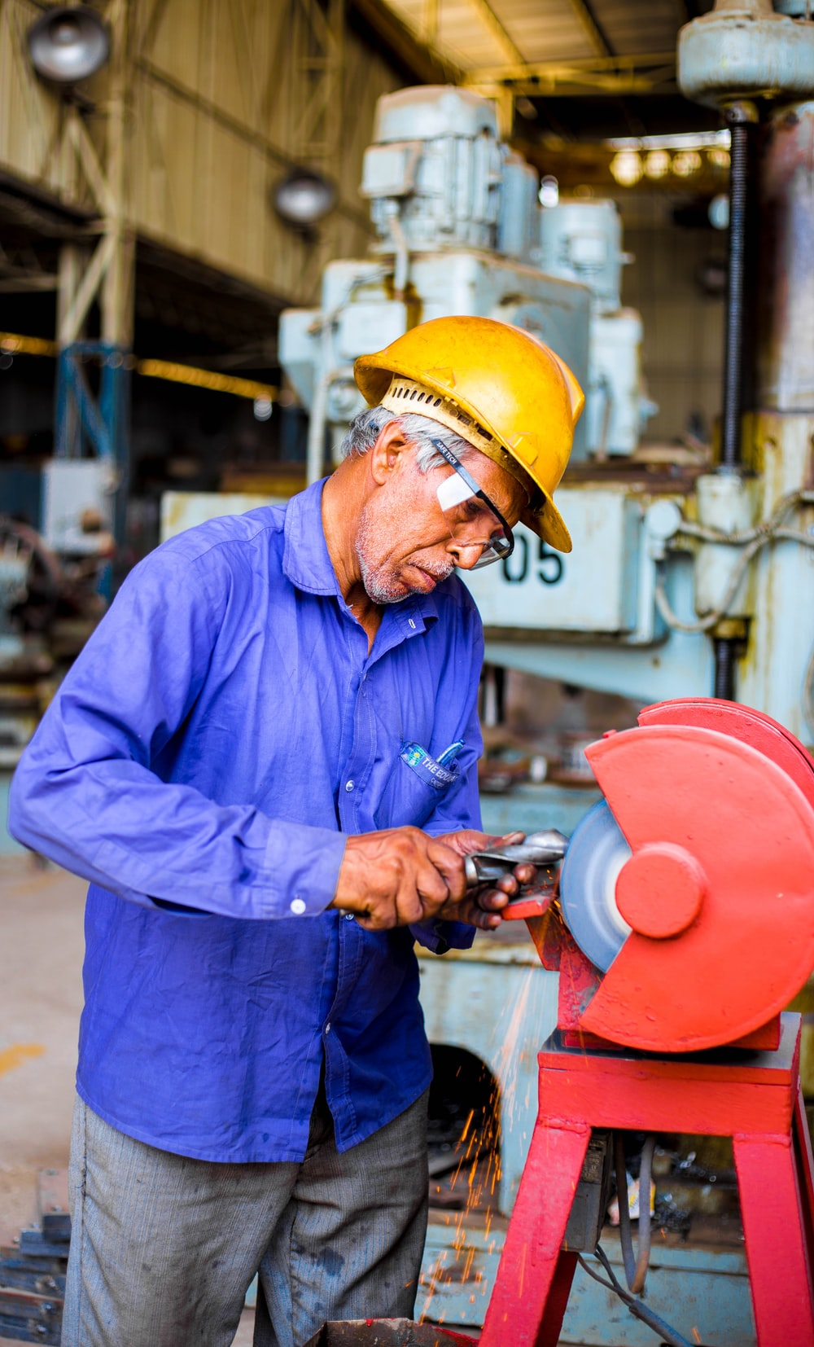
Goal of Project
Our goal is to transform the manual and time-consuming task of verifying personal protective equipment (PPE) with the help of cloud computing, computer vision, and intelligence.

Slide 3
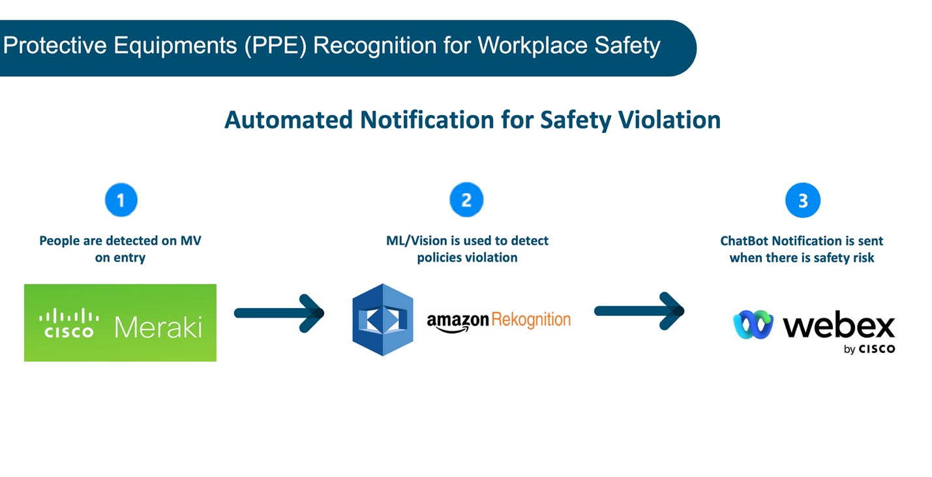
High Level Diagram:
The solution automatically sends alerts to administrator and violator when safety gear violations are detected on camera.

Slide 4
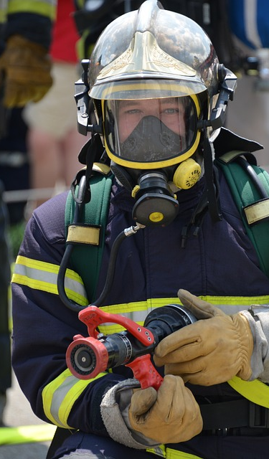
Business Challenges:
Violations of safety regulation standards lead to legal and financial issues for the organizations in many industries (manufacturing, health care, oil and gas, etc.).
Unfortunate workplace accidents happen without proper monitoring of personal protective equipment's (PPEs). Additionally, improper use of PPEs can endanger your employees.
The traditional method of verifying PPE requires dedicated people positioned at all site’s ingress to check and notify employees/guest upon entry. This method is prone to human error and not scalable.

Slide 5
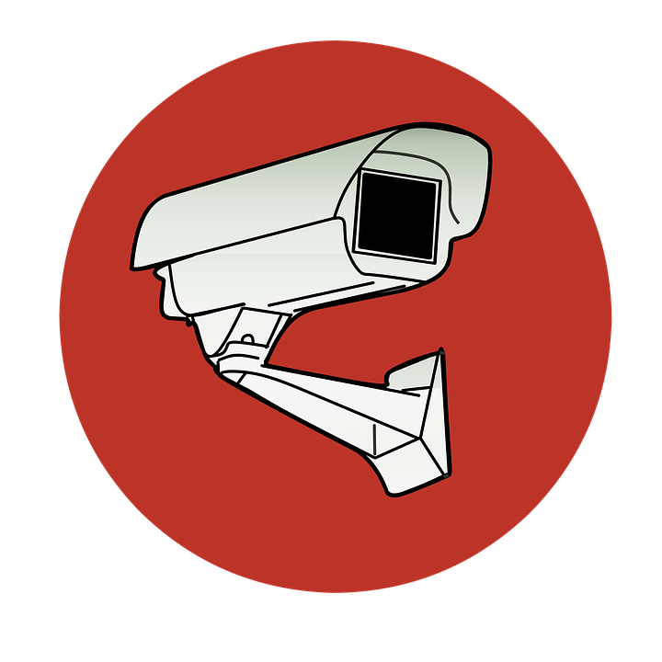
Weaknesses in other detection solutions:
Only detects a single type of PPE gear
Only work with a single camera, does not scale in a realistic production environment.
Does not have automated notification to person with violation, which requires additional human intervention
No data collection mechanism for future analysis, investigation.

Slide 6
Our solution:
Hurdles | Solution
Single gear | We leverage AWS Rekognition to provide detection for a wide range of PPEs; including hard hats, gloves, masks, etc. Our solution can also detect if the equipment is equipped incorrectly.
Single camera | Our solution subscribes to multiple cameras throughout the customer premises. Detection policies can be set for each camera depending on the type of PPE required for the site.
No direct notification | By incorporating facial recognition, we can identify the identity of the employees violating PPE regulation, and directly notify them to adjust their equipment.
No data collection | Captured events are logged to the database, for any future analysis that the customer would like to perform.

Slide 7
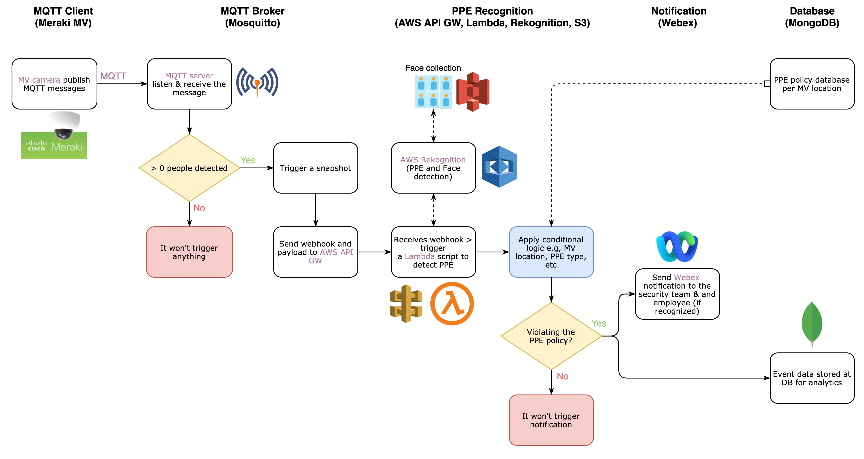


Solution LLD Diagram:

Slide 8
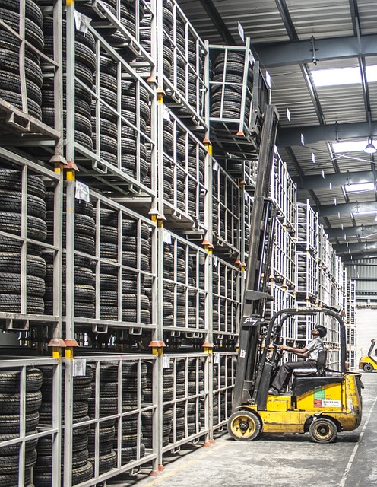
Methodology:
Customers with Meraki camera installed on their campus and Webex for collaboration can easily deploy this solution. Our project leverages these Cisco and 3rd party solutions:
Meraki MV Sense API
Webex API
AWS Lambda
AWS Rekognition
MongoDB Atlas

Slide 9
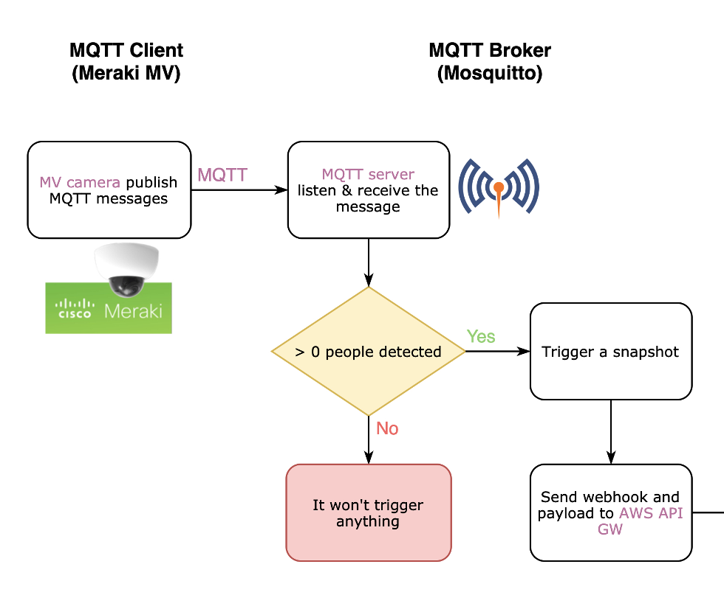
 | MQTT Broker and Meraki Snapshot
 | Set up MQTT Broker to trigger MV snapshot when there is people detected in the FOV. Snapshot event triggers AWS Lambda for vision analysis.
Logic Flow Diagram: |  | Expected Outcome: MQTT broker trigger the MV snapshot each time a person is detected on camera. The function collection the snapshot URL, the camera name and SN, the time of event into a payload. Webhook with payload is sent to AWS to begin the image processing. Code Repository: https://github.com/mfakbar/meraki-ppe-detection

Slide 10
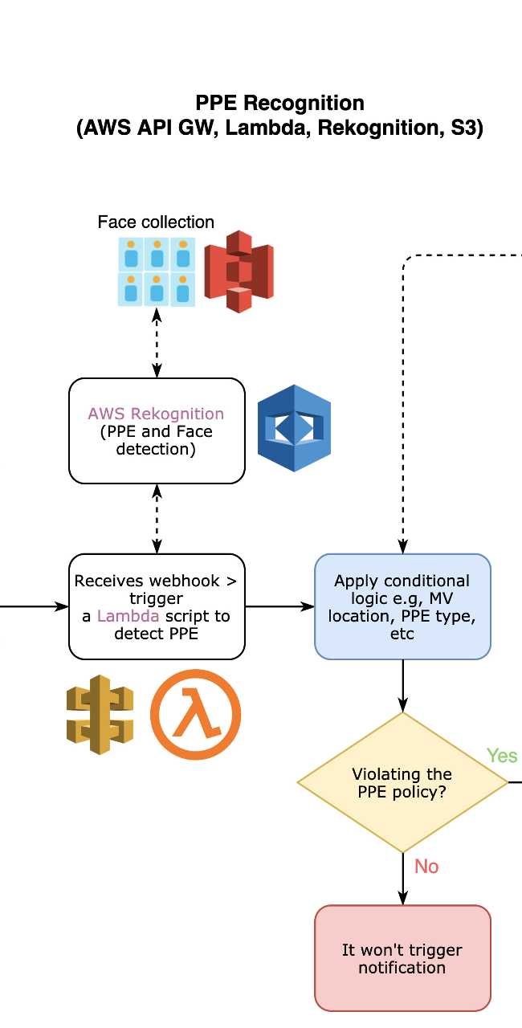
 | PPE Recognition with Lambda
 | The snapshot triggers the Lambda script to run computer vision analysis (via Rekognition). Logic conditions (MV location, PPE type, etc.) are checked to determine if there is a safety violation detected.
Logic Flow Diagram: |  | Expected Outcome: Snapshot triggers the Lambda script to run CV analysis. Conditions are checked to determine possible PPE safety violation. Checks are carried out for identity detection against facial database stored in S3 Code Repository: https://github.com/mfakbar/meraki-ppe-detection

Slide 11
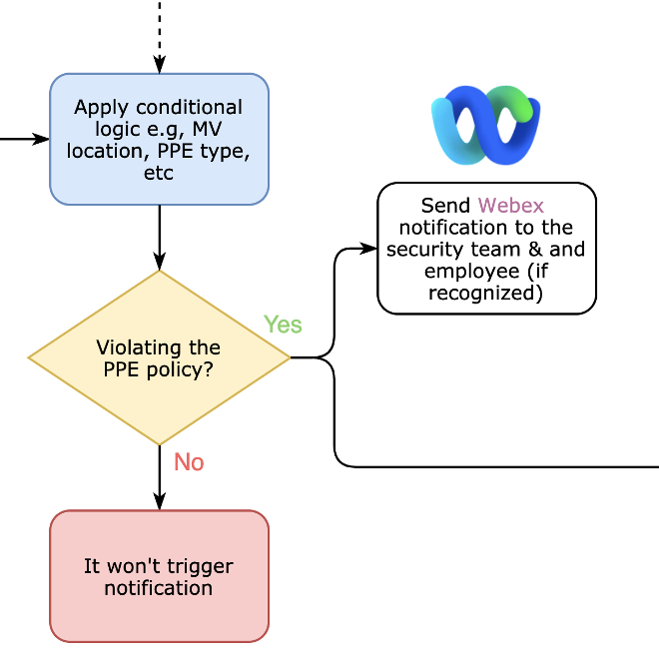
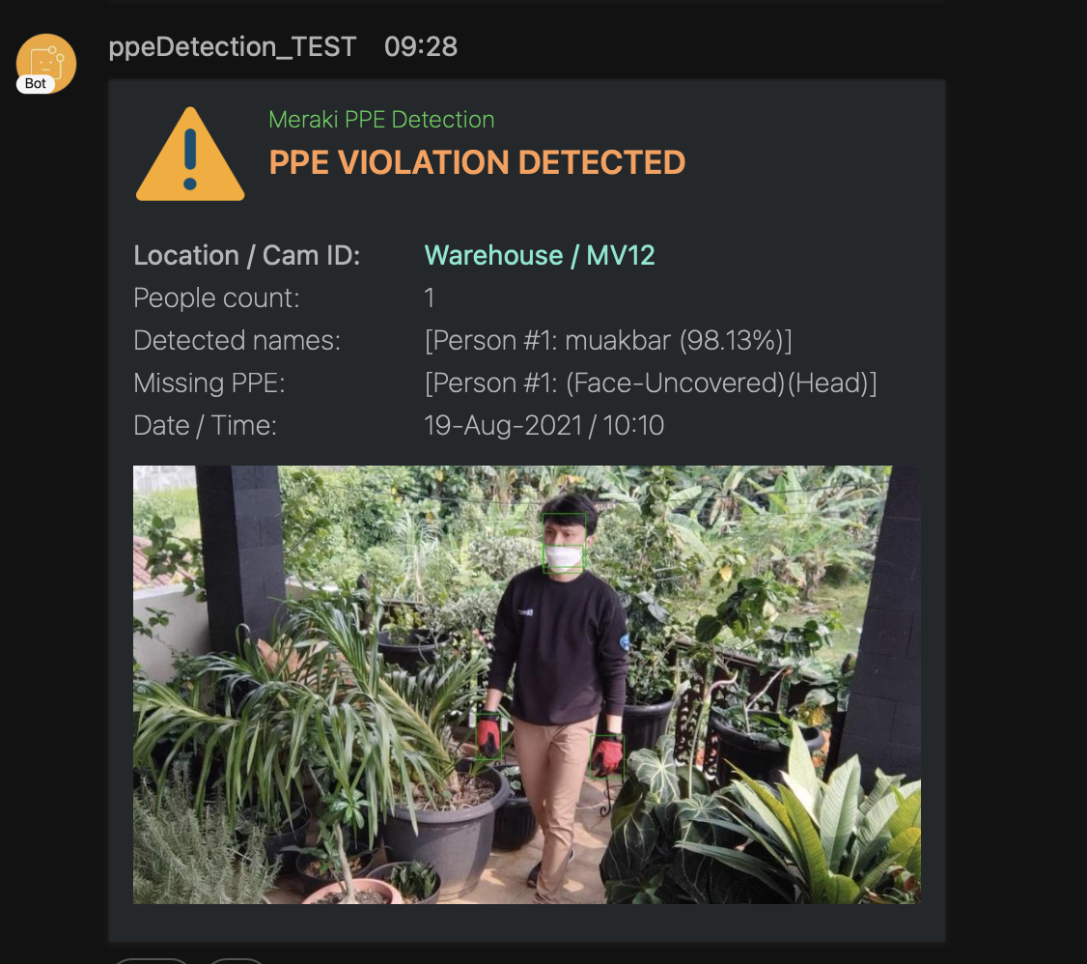
 | Notification with Webex
 | The Webex alert card includes: Time and location of detection, list of missing PPEs, camera ID, snapshot of the detection. The alert is also sent to the violator if there is a facial identification match.
Logical Flow Diagram: |  | Expected Outcome: Webex alert is sent to administrator with details. Including location, datetime, missing PPEs, person’s identity, camera ID:

Slide 12
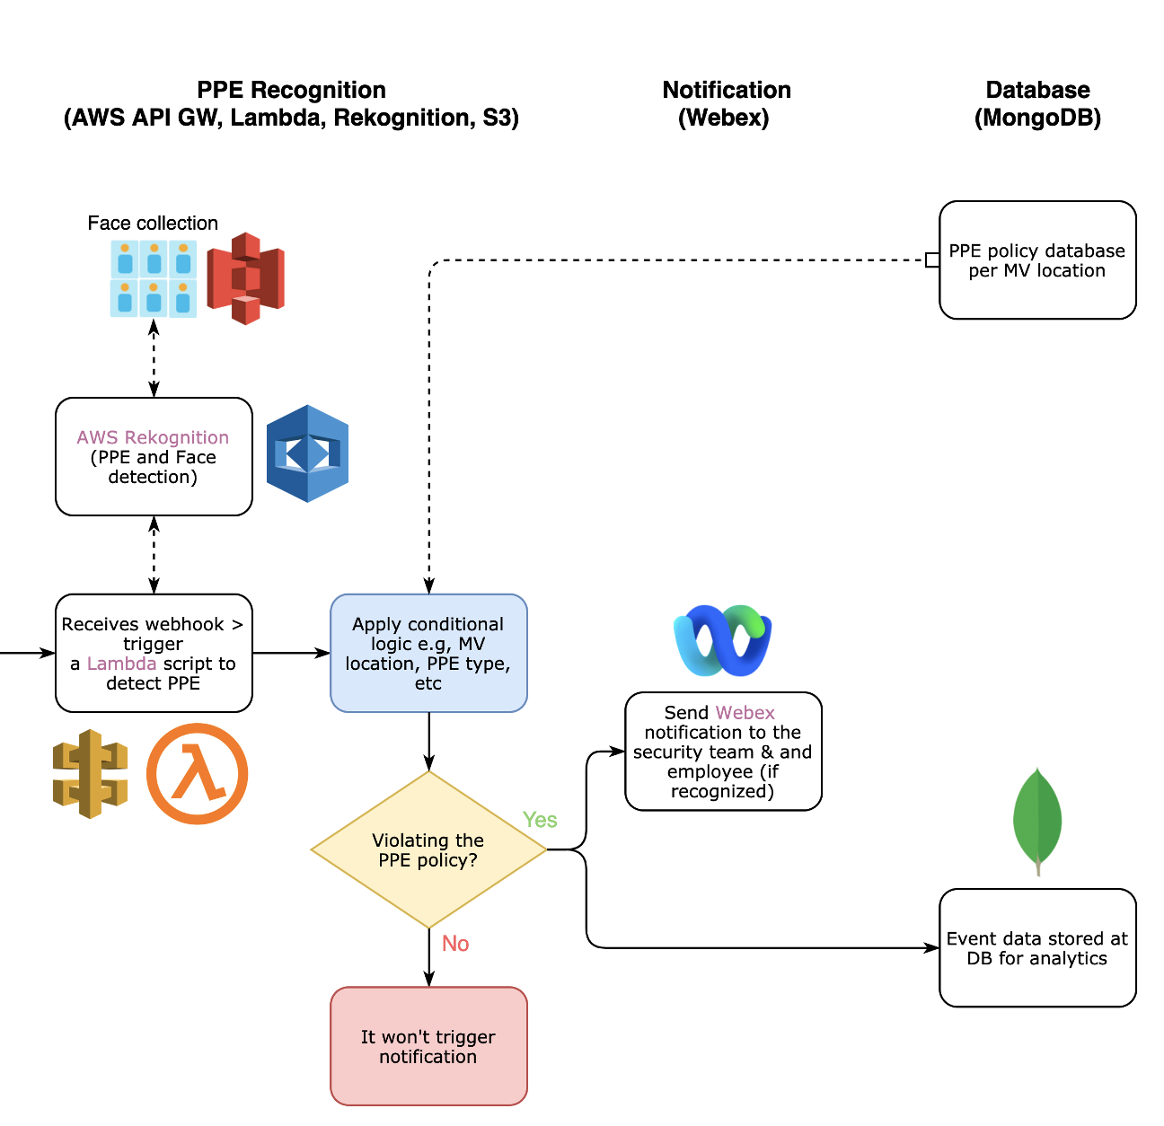
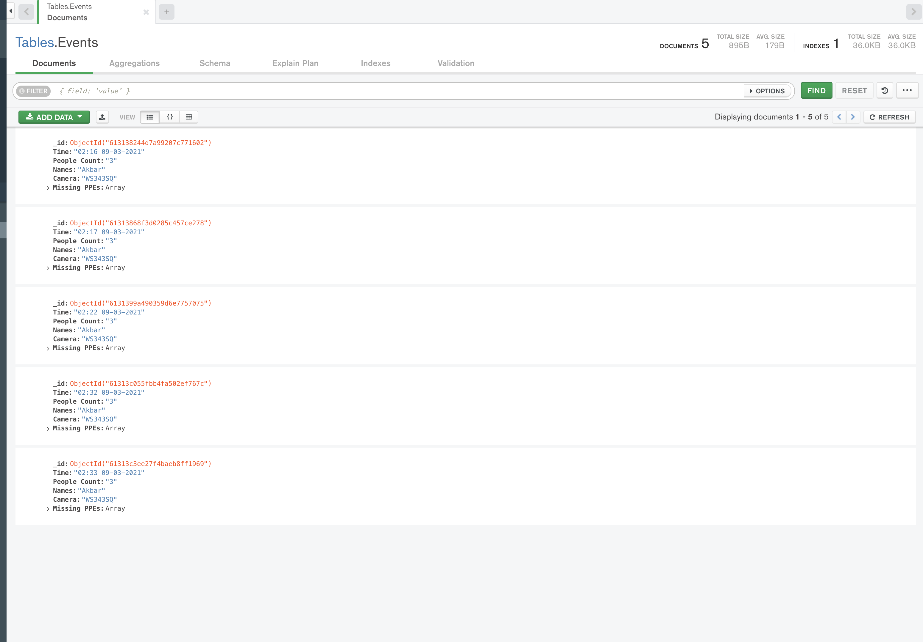
 | Database Log with MongoDB
Logical Flow Diagram: |  | Expected Outcome: Event details like time of occurrence, camera name on which violation was detected, etc. is extracted to MongoDB database for future investigation

Slide 13

Thank You, Stay Safe.

